Slide 1
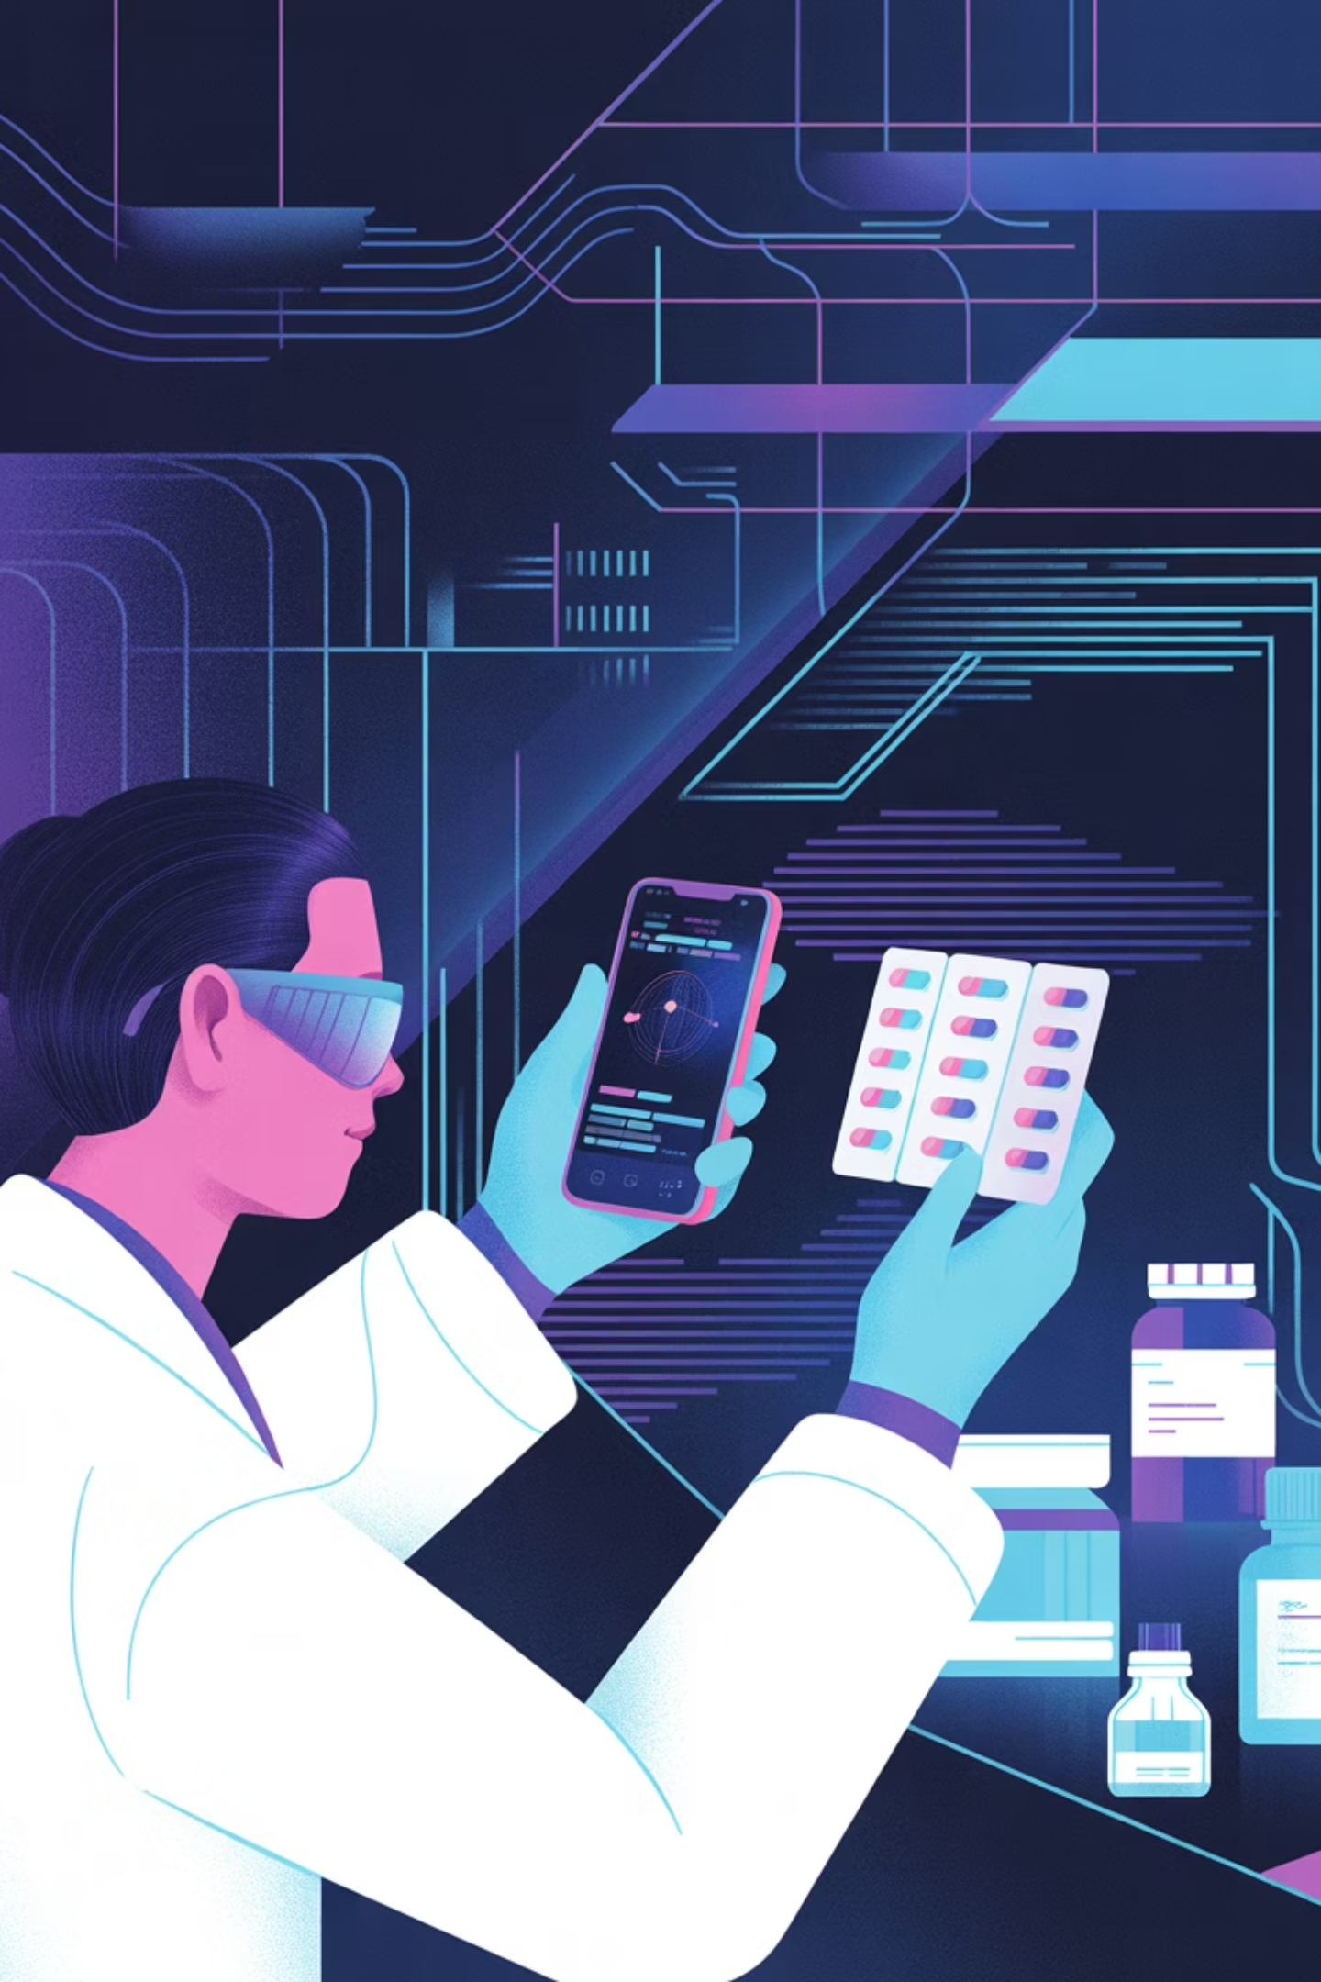
A Deployable Multimodal Framework for Automated Counterfeit Medicine Detection
Presented by Rafiur Rahman Mashrafi
ID: 2221971042

Slide 2
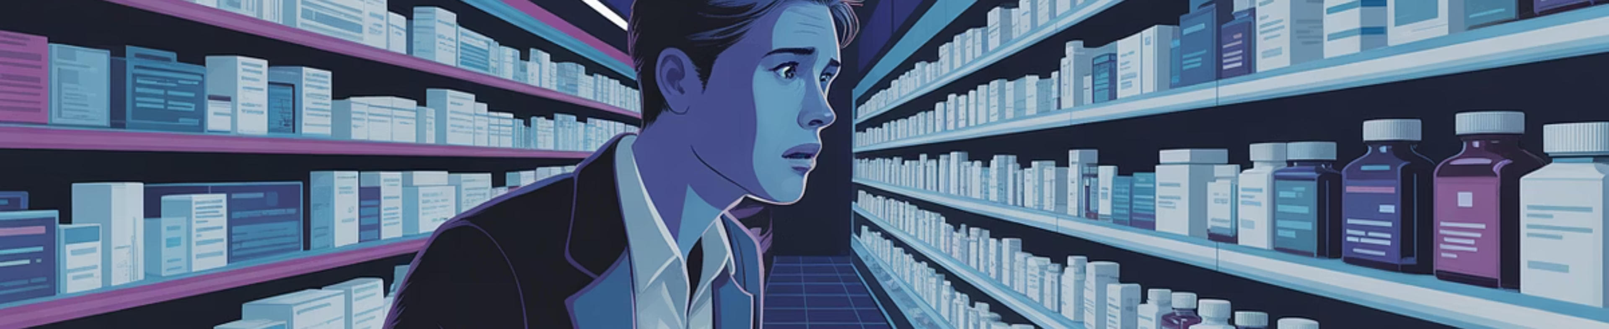
The Problem
Counterfeit Medicines: A Global Health Crisis
Fake drugs threaten lives across developing nations and developed markets alike—current detection fails consumers and pharmacists

Slide 3
The Challenge: Inadequate Detection & Our Innovative Solution
Current Detection Challenges
Our Goal
Counterfeit medicines are a global health crisis, especially in developing regions like Bangladesh and India, and even affecting developed nations like the USA.
To develop a low-cost, multimodal, AI-driven mobile system that detects counterfeit medicines by fusing computer vision, OCR, and lightweight verification using smartphone images and textual data—validated on real-world medicine samples from low-resource regions.
Current detection methods are inaccessible or inadequate:
Lab testing (expensive, slow, requires experts)
Blockchain-only systems (verify supply chain but cannot detect visual counterfeits like fake packaging with cloned QR codes)
Pure image-based AI (lacks text/serial number verification, vulnerable to sophisticated fakes).
American counterfeit drugs often involve falsified prescription opioids (e.g., fentanyl-laced pills) that evade traditional detection.
Existing AI solutions rely on small, synthetic, or private datasets, limiting real-world applicability.
There is a lack of integrated, multimodal, and deployable systems for real-time verification by consumers and pharmacists across different regulatory environments.

Slide 4
Related Works - Existing Approaches & Their Limitations
CNN-Based Image Classification (Irhebhude et al. 2024, Thomson & Varuna 2025)
Limited to visual features; private datasets; no text or context analysis.
Multimodal LLMs (Zakaria et al. 2024)
Low accuracy (~74%), needs reference images, not robust in poor conditions.
Blockchain-Only Systems (Sanghi et al. 2021, Islam 2022)
No AI detection; assumes stakeholder cooperation; scalability issues.
Hybrid AI + Analytical Methods (Alsallal et al. 2018)
Small datasets; not real-time; requires special hardware (XRF).
Research Gap Identified: No system combines computer vision + OCR + blockchain + real-time deployment.
Lack of public, diverse, real-world datasets.
Limited explainability and robustness testing in varied environments.

Slide 5

Proposed Work Plan (4-Phase, 4-Month Capstone Timeline)
Phase 1: Dataset Curation & Preprocessing (Weeks 1–4)
Phase 2: Multimodal Model Development (Weeks 5–10)
Collect 5,000+ images of common medicines (genuine + verified counterfeits)
Annotate with labels: logos, text regions, batch numbers, expiry dates
Augment data with synthetic variations to simulate real-world conditions.
Train YOLOv8n for logo & packaging detection
Integrate EasyOCR for text extraction (serial numbers, expiry)
Build fusion logic combining visual + text confidence scores
Incorporate explainability (Grad-CAM) for model transparency.
Phase 3: Mobile System Integration (Weeks 11–14)
Phase 4: Evaluation & Deployment Readiness (Weeks 15–16)
Develop Android app prototype (React Native / Flutter)
Test under varied conditions: poor lighting, blur, damaged packaging
Compare with baselines: pure CV vs. pure OCR vs. fused approach.
Evaluate using Accuracy, Precision, Recall, F1, Inference Time
Conduct user study with local pharmacists for real-world feedback
Prepare final report, presentation, and demo video.

